Slide 1

using R for reproducibility and replicability
Emily Rempel
Department of Psychology and the Institute for Policy Research
University of Bath

Slide 2
Outline
See github.com/SISBID/Module3/
for the course by Keith Baggerly and Karl Broman
Set the issues related to reproducibility
Talk about R
Quick introduction to R
Git and GitHub and R
Resources

Slide 3
What do I mean by reproducibility versus replicability?
Replicability – “If I use the same methods (and run the study again), I would get the same results.”
Reproducibility – “If I use the same data (from the same study), I would get the same results.”
Essentially the ‘foundation of science’…
Notes:
These are contested…not all agreed upon definitions but we can point to at least two different phenomenon…

Slide 4
Is this a problem?
Depends on your epistemological stance.
The scientific method is based on the ability to test other people’s hypotheses.
Causality = replicability
But reproducibility is easier (and less expensive) than replicability.
“A minimal standard for data analysis and other scientific computations is that they be reproducible.”
– Karl Broman

Slide 5
The ‘Replication Crisis’ in Psychology
In 2015, the Open Science Collaboration reported in Science that of 100 social psychology studies tested only 39% were replicable.
“Nonetheless, collectively these results offer a clear conclusion: A large portion of replications produced weaker evidence for the original findings despite using materials provided by the original authors, review in advance for methodological fidelity, and high statistical power to detect the original effect sizes.”
Hypothesised reason: Journals prioritise novelty and have a positive publication bias.

Slide 6
The ‘Replication Crisis’ in Psychology
However, in response to this Gilbert et al. (2016) conducted a reproducibility experiment with the OSC data and found…
“Although that seems rather unlikely, OSC’s data clearly provide no evidence for a “replication crisis” in psychological science.”
Big issue: The OSC did not adjust for population effects.
While focusing on replicability the OSC’s own analysis had issues with reproducibility.

Slide 7
Out of 2,155 US ‘academic psychologists’…
(John et al., 2012)

Slide 8
The ‘Replication Crisis’ not in Psychology
It’s not just psychology or social science:
Publication Bias is everywhere
Bad Science is everywhere
See ‘The Duke University scandal’ uncovered by Keith Baggerly
Big issue in big data as ‘errors get lost’
Ed Yong in the Atlantic points to the larger issue by saying…
“Second, it can be very easy to see this as an academic spat about turgid statistical matters like p-values, and degrees of freedom, and publication bias. It’s not. It’s about people’s lives. Their careers. Their passions. Their futures.”

Slide 9
Links…
Original OSC Paper: http://science.sciencemag.org/content/349/6251/aac4716
Response to OSC Paper: http://projects.iq.harvard.edu/files/psychology-replications/files/gilbert_king_pettigrew_wilson_2016_with_appendix.pdf?m=1456973260
Atlantic’s Article on both: https://www.theatlantic.com/science/archive/2016/03/psychologys-replication-crisis-cant-be-wished-away/472272/
Duke University Scandal: http://biostat.mc.vanderbilt.edu/wiki/pub/Main/MSJournalClub/DukeScandal.pdf
Study on US psychologists: http://journals.sagepub.com/doi/abs/10.1177/0956797611430953

Slide 10
How does this relate to R?
Reproducibility is not just about data but also about methods, in the case of data analysis this means code.
Open and transparent coding and data!
R is a free statistical package that anyone can download, therefore collaborators do not need to worry about buying expensive software.
R is also not point-and-click!
Statistical coding is not scary!

Slide 11

Introduction to R Outline
Why use R?
Syntax and packages
R versus RStudio
Basic syntax:
Cleaning
Descriptives
Regression/T-tests

Slide 12
Why use R?
It does everything (and more) compared to any other statistical package.
You do not need to separate out kinds of analysis to kinds of software.
You only come up to limitations in file size if you are analysing big data (say TB not GB).
It is easy (trust me) once you get the basics.
Packages are AMAZING and save time! See tableone.
You can create some awesome graphics.

Slide 13
Why use R?
It’s free!

Slide 14
R Syntax and Packages
R analysis is done using the R language which is a relatively logical coding system that automates ALL point and click software functions.
For example, typing MyData <- read.csv(“X:/Psychology….”) loads your data
R Packages are assemblages of R Syntax that further automate functions.
A basic example is doing linear regression instead of writing out the formulas it is automated with Model <- lm(DV ~ IV, data=YOURDATA)
A nice example is ‘tableone’ which automates the formatting and structure of your tables.
Each package has a series of commands within it to do fun things.
Syntax and output are on the same screen.

Slide 15
R versus RStudio
R is the basic software.
RStudio (not free for everyone, but free for us) is an easier to use platform based on R.
But R still does everything you need for statistical analysis.
RStudio gives you the option for Rmarkdown (and linking to Git) which lets you format documents within R and automatically turn them into PDFs, HTML, Word etc. → Like Latex light…

Slide 16
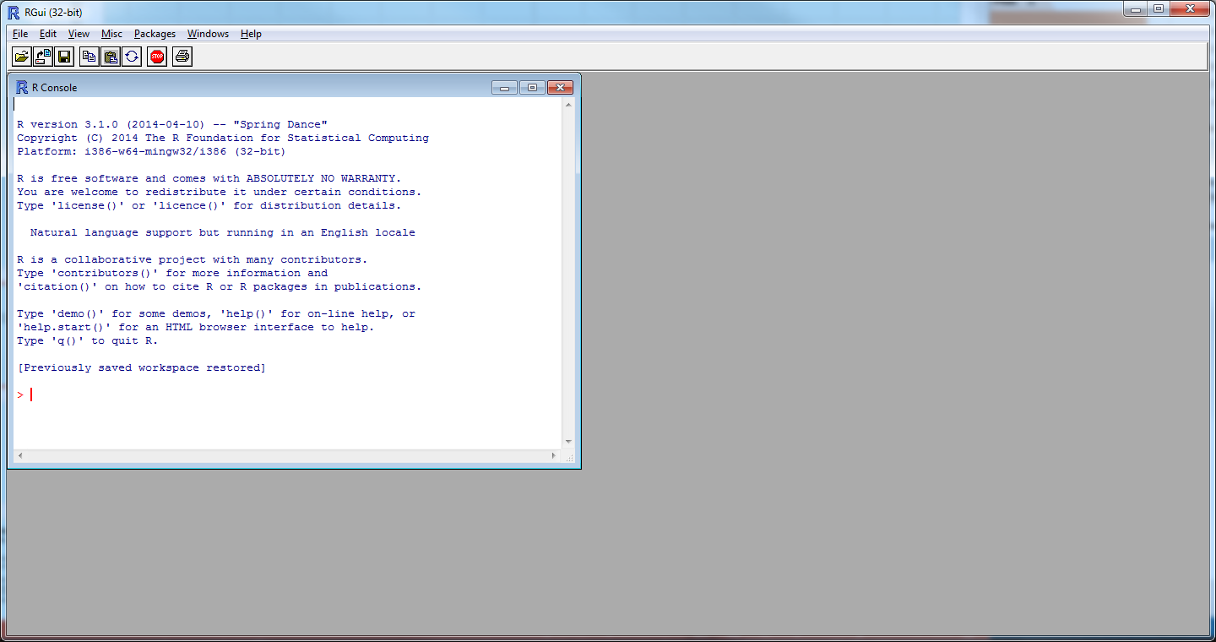

Slide 17
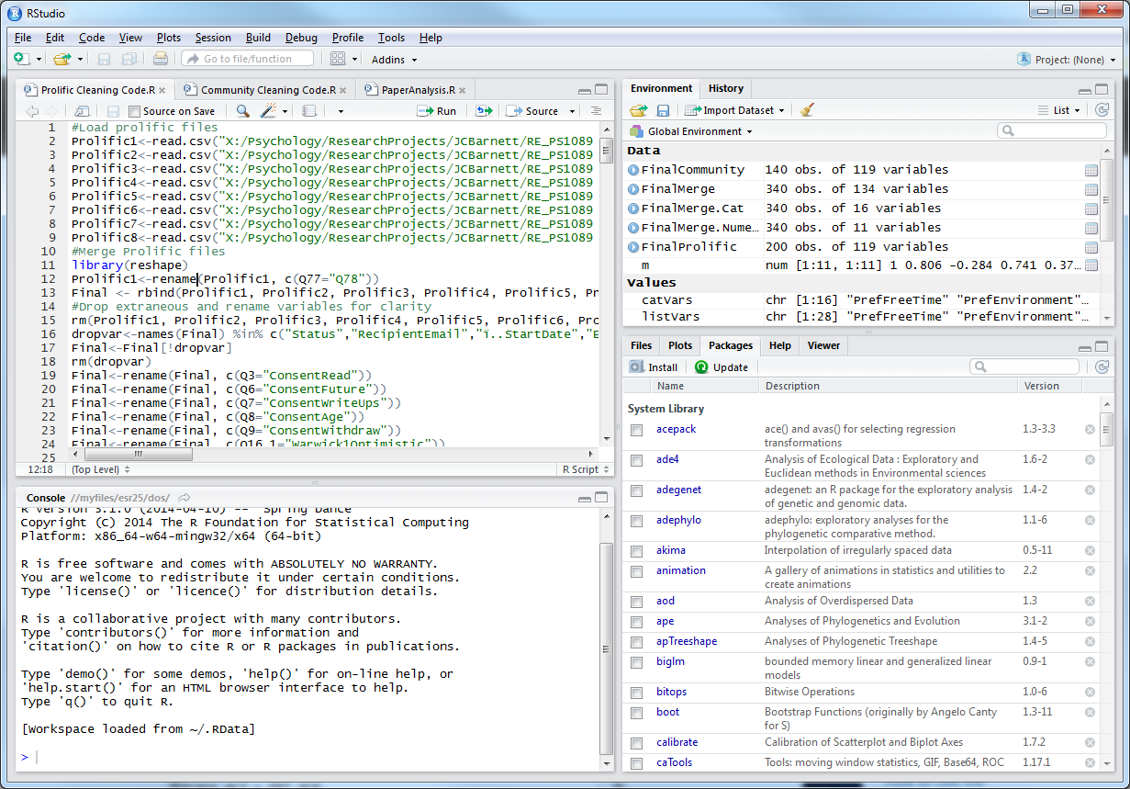

Slide 18
Basic Syntax
Installing and loading packages
Installing new packages: install.packages(“nameofpack”)
Loading a package before working with it: library(nameofpack)
Reading your data
Loading csv data: MyData <- read.csv(“X:/Psychology….”)
Loading txt data: MyData <- read.table(“X:/Psychology….”, header=TRUE)
Creating a variable or matrix
Assigning a value: X <- 1
Making a matrix (i.e. a table): mymatrix = matrix(1:20, nrow=4, ncol=5, byrow=FALSE)
Renaming variables: mydata$Variable2<-mydata$Variable1
Re-assigning variables types from categorical to numeric: mydata$Variable1<- as.numeric(mydata$Variable1)

Slide 19
Useful codes when starting out
Means and descriptives
Creating a generic summary: x<-summary(mydata)
Just getting the mean: mean(mydata$specificvariablename)
Basic t-tests and linear models
Independent 2-sample t-test: Myttest<-t.test(y~x)
Basic linear regression: Model <- lm(DV ~ IV, data=YOURDATA)
Some other fun codes:
Clear your workspace: rm(list=ls())
How many rows and columns: dim(mydata)
What do the first few rows look like: head(mydata)
What are my variable names: names(mydata)

Slide 20
Some points about why it’s useful for you (not just others) from SISBID3…
“Your closest collaborator is you six months ago, but you don’t reply to emails.”
-SISBID3-
Can easily re-run analysis if data changes.
Can find errors in analysis because it’s all in one place.
Easier to critique analysis and adjust.
Just one button to re-run instead of many buttons, e.g. point and click takes more time.
You should never need to manually adjust data, code can do EVERYTHING.

Slide 21
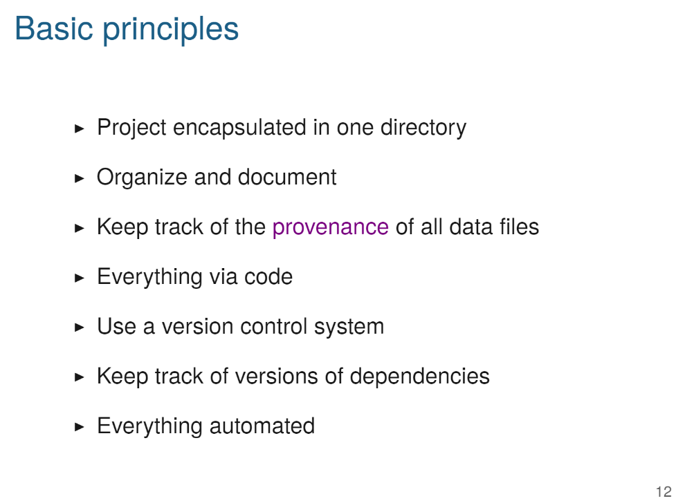
What do you need to do with R (and Git/GitHub) to ensure reproducibility?

Slide 22
I am not a Git (hub person)

Slide 23
(An oversimplified) Introduction to Git
Git is a (free) version control system, that uses ‘command prompt’ on a PC or ‘terminal’ on a Mac.
Essentially it’s about tracking and automation of file updates and naming
Rstudio links with Git, so that any changes you make to files and the structure of your folders is automatically tracked:
Set up a ‘repo’ or empty directory
Add stuff in to it
Edit stuff within it
You can track all of your changes and ‘branch’ and ‘merge’ versions
Notes:
These are software development tools that can be leveraged for academic research.
Git was created by americans.

Slide 24
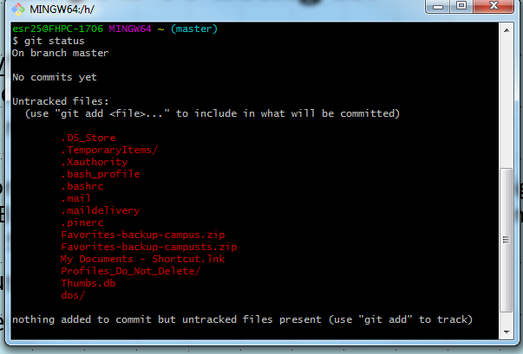

Slide 25
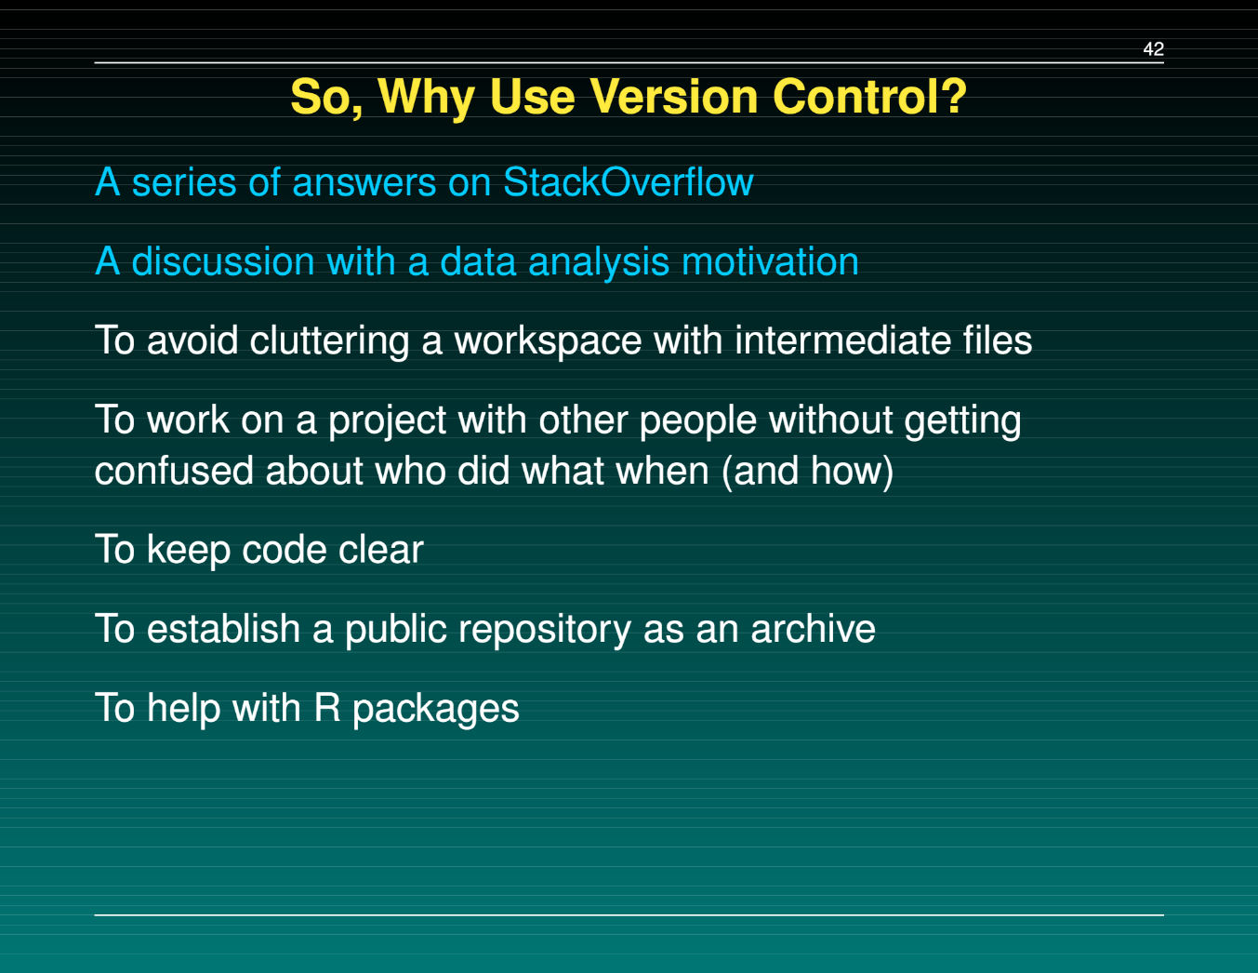
Intro to Git

Slide 26
(A limited) Introduction to GitHub
Going beyond tracking your own work, GitHub allows you to share and collaborate using Git commands. It’s free to a limit…
Essentially it’s the same as Git, a version control system that hosts project directories, BUT it’s hosted online!
You can ‘push’ directories from your desktop/system online.
Allows other people, editors, etc. to look at the progress of your project and investigate your code.
Essentially it allows for very, very open and transparent coding.
BUT also collaboration (Forking and Cloning).

Slide 27
Caveats
This is not the only way to do this.
There are other coding languages and stats syntaxes.
I am not even that good at Git or GitHub.
Do you want to share all kinds of data? No!
Do you want to be transparent about your analysis? Yes!
Reproducibility is a lifestyle choice not a set of exact procedures.

Slide 28
Resources to learn more…
R courses:
(From an email chain a while back) https://www.coursera.org/learn/exploratory-data-analysis
https://www.datacamp.com/courses/free-introduction-to-r
https://www.codeschool.com/courses/try-r
https://www.statmethods.net/index.html
https://stats.idre.ucla.edu/other/dae/
PG Skills Courses
http://www.bath.ac.uk/learningandteaching/rdu/courses/pgskills/training/RP00389.html
http://www.bath.ac.uk/learningandteaching/rdu/courses/pgskills/training/RP00391.html
Git/GitHub Links:
https://git-scm.com/downloads
https://github.com/
https://www.codecademy.com/learn/learn-git
https://www.codecademy.com/learn/learn-the-command-line
Courses on Reproducibility:
https://github.com/SISBID/Module3/
https://kbroman.org/Tools4RR/
https://cmsw.mit.edu/how-im-writing-my-thesis/

